Slide 1
K-Means
By Arunkumar Nair
arunkg99@gmail.com
91-9890652675
https://www.linkedin.com/in/arunkumarnair/

Slide 2
K-Means
The k-means algorithm is an unsupervised clustering algorithm. It takes a bunch of unlabeled points and tries to group them into “K” number of clusters.
Used unlabeled data (Data without defined categories or Group)
Data points are clustered based on similarities
The goal of this algorithm is to find groups in the data, with the number of groups represented by the variable K.

Slide 3
How the K-means algorithm works
The K-means algorithm identifies k number of centroids, and then allocates every data point to the nearest cluster, while keeping the centroids as small as possible.
The ‘means’ in the K-means refers to averaging of the data; that is, finding the centroid.

Slide 4
How the K-means algorithm works
K-means algorithm in data mining starts with a first group of randomly selected centroids, which are used as the beginning points for every cluster, and then performs iterative (repetitive) calculations to optimize the positions of the centroids
It halts creating and optimizing clusters when either:
The centroids have stabilized — there is no change in their values because the clustering has been successful.
The defined number of iterations has been achieved.

Slide 5
How it works?
Step 1: Determine K value by Elbow method and specify the number of clusters K
Step 2: Randomly assign each data point to a cluster
Step 3: Determine the cluster centroid coordinates
Step 4: Determine the distances of each data point to the centroids and re-assign each point to the closest cluster centroid based upon minimum distance
Step 5: Calculate cluster centroids again
Step 6: Repeat steps 4 and 5 until we reach global optima where no improvements are possible and no switching of data points from one cluster to other.

Slide 6
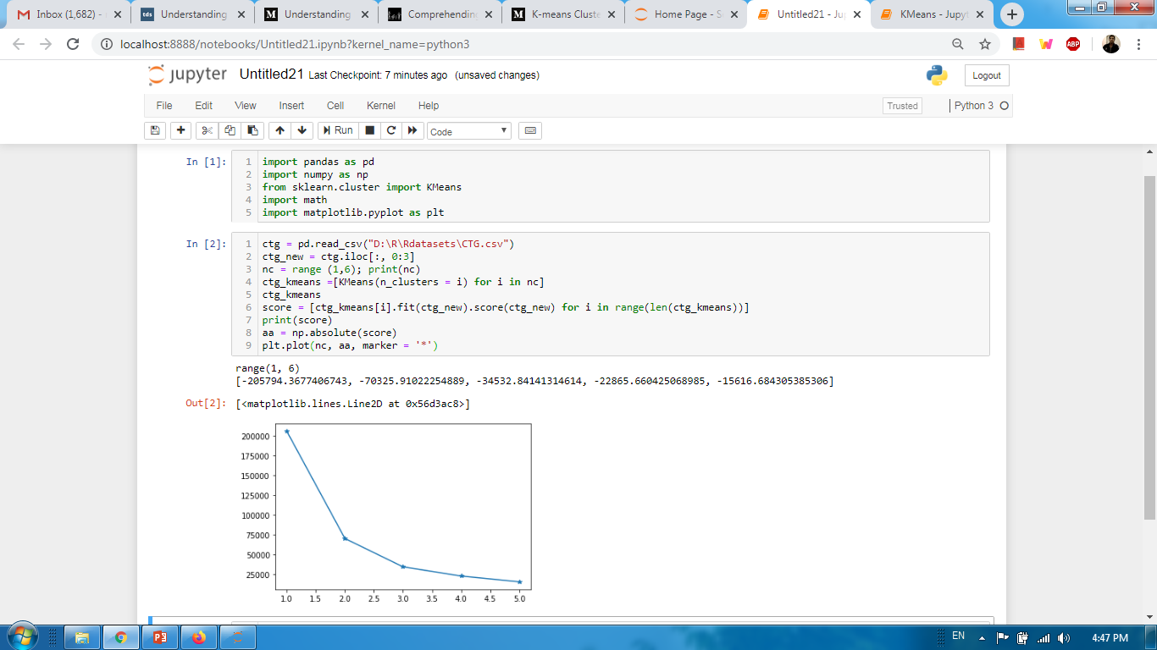
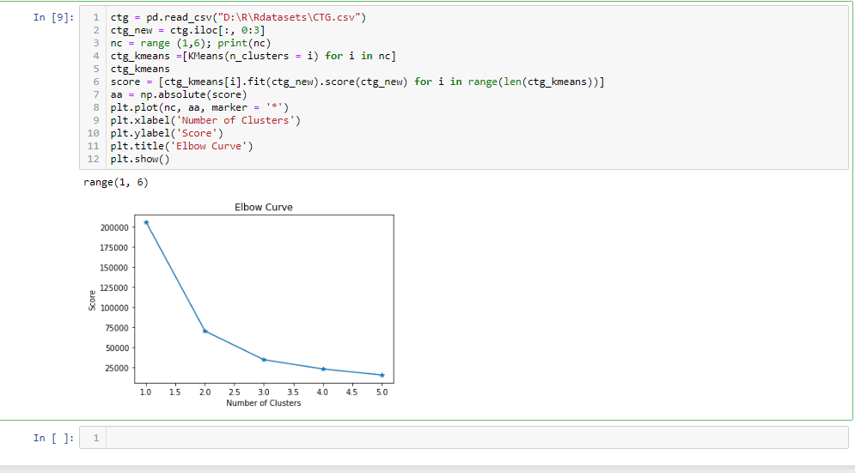
Implementation using python

Slide 7
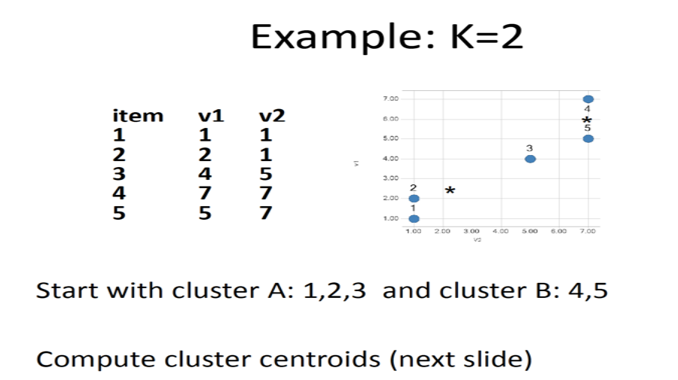

Slide 8
B
A

Slide 9
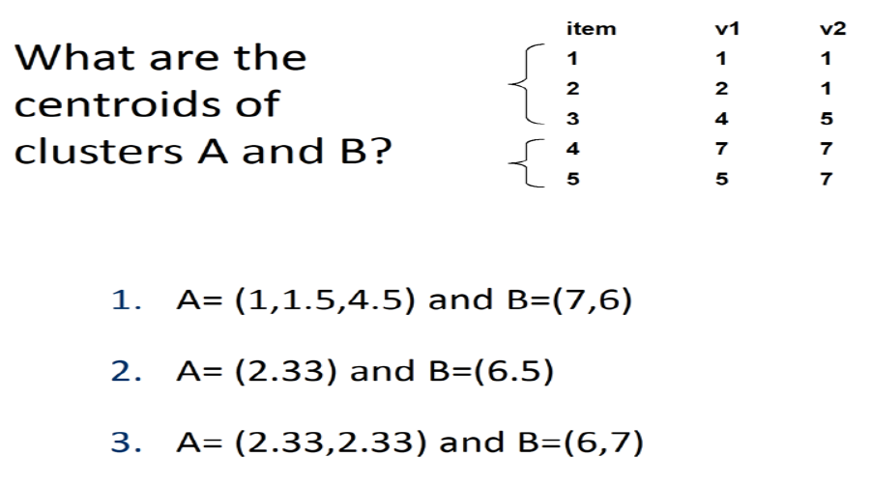
1
1.5
4.5
7
6
7/3
13/2

Slide 10
1
2.33
2.33
1.5
4.5
7
6
6
7
7/3
13/2

Slide 11
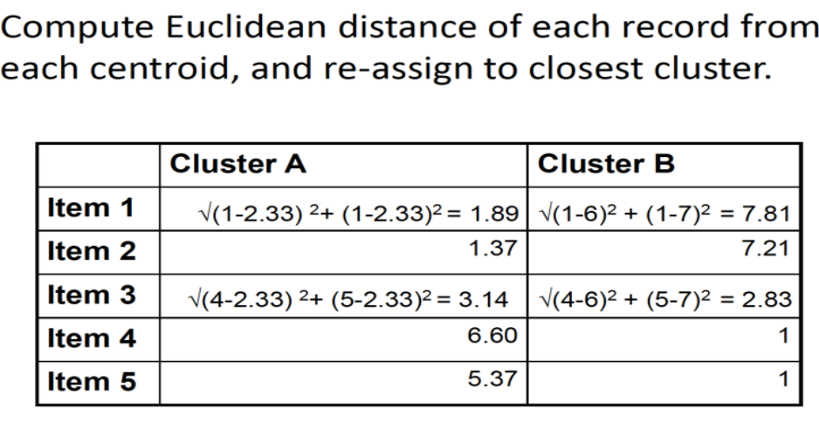

Slide 12
B
A

Slide 13
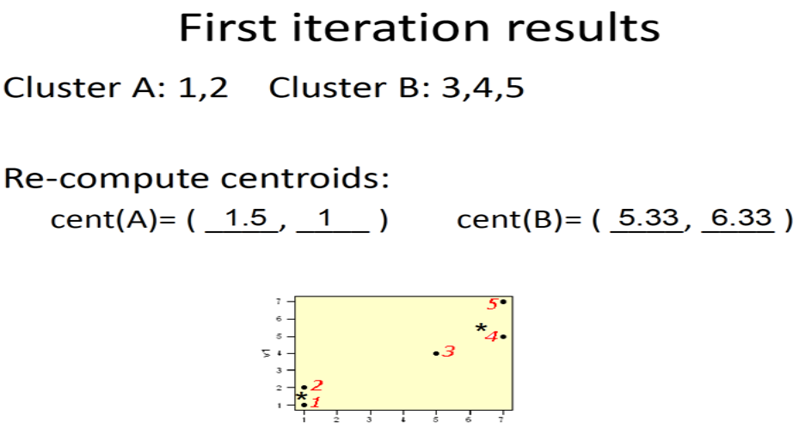

Slide 14
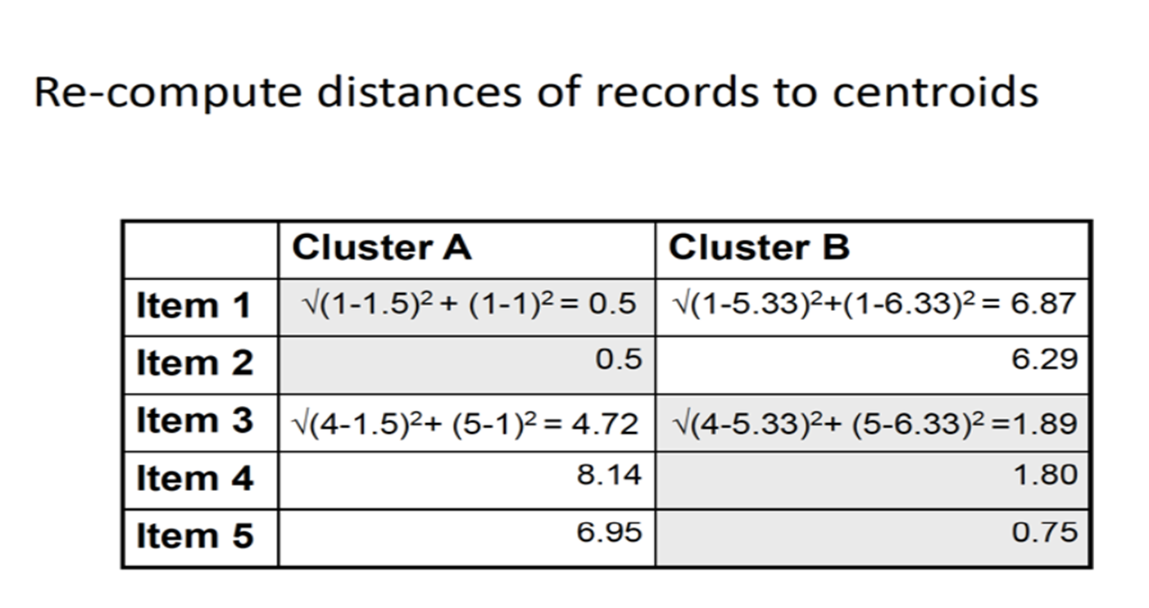

Slide 15
Common business cases where K-means is used
Behavioral segmentation:
  Segment by purchase history
  Segment by activities on application, website, or platform
  Define personas based on interests
  Create profiles based on activity monitoring
Inventory categorization:
  Group inventory by sales activity
  Group inventory by manufacturing metrics
Sorting sensor measurements:
  Detect activity types in motion sensors
  Group images
  Separate audio
  Identify groups in health monitoring
Detecting bots or anomalies:
  Separate valid activity groups from bots
  Group valid activity to clean up outlier detection

Slide 16
What is KNN
A Powerful classification algorithm used in pattern recognition
K-nearest neighbors store all available cases and classifies new cases based on a similarity measure (e.g. distance function)
One of the top data mining algorithm used today
A non-parametric lazy learning algorithm (an instance based learning method)

Slide 17
Different names of KNN
K-nearest Neighbors
Memory-Based Reasoning
Example-Based reasoning
Instance-Based learning
Lazy Learning

Slide 18
KNN- Classification Approach
An object (a new instance)is classified by a majority votes for its neighbor classes
The object is assigned to most common class amongst its K nearest neighbors (measured by a distance function)

Slide 19
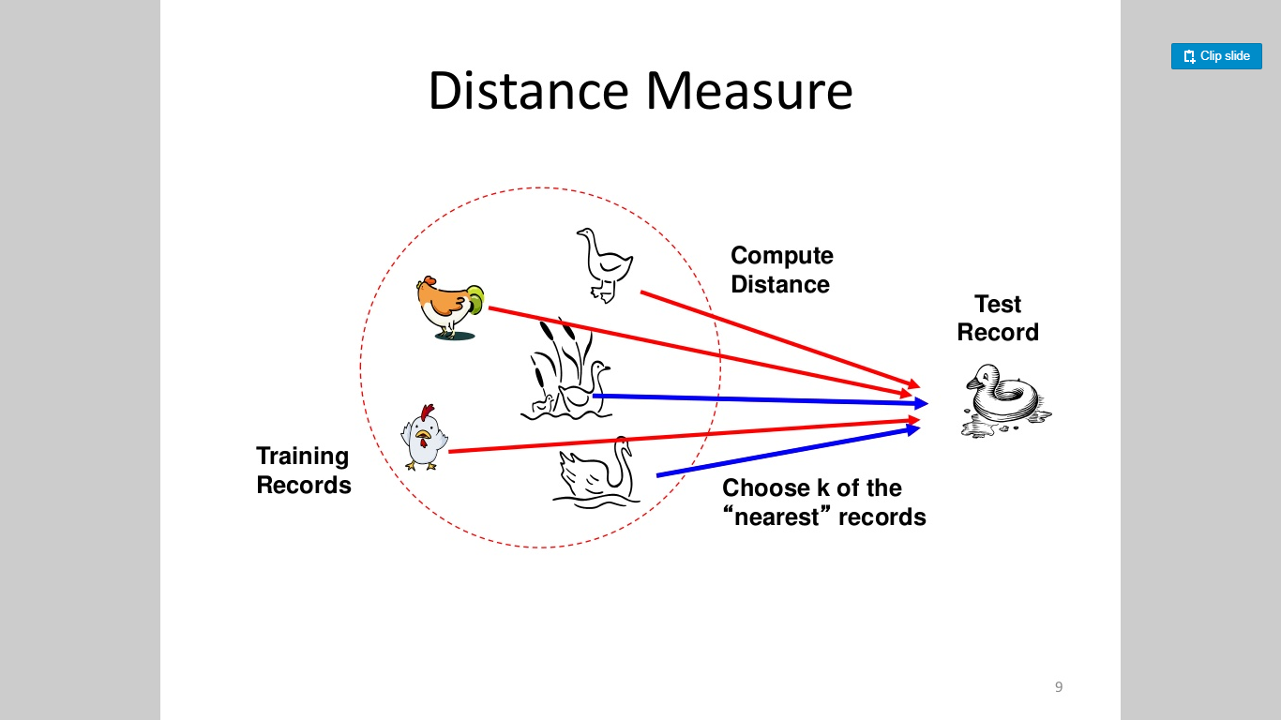

Slide 20
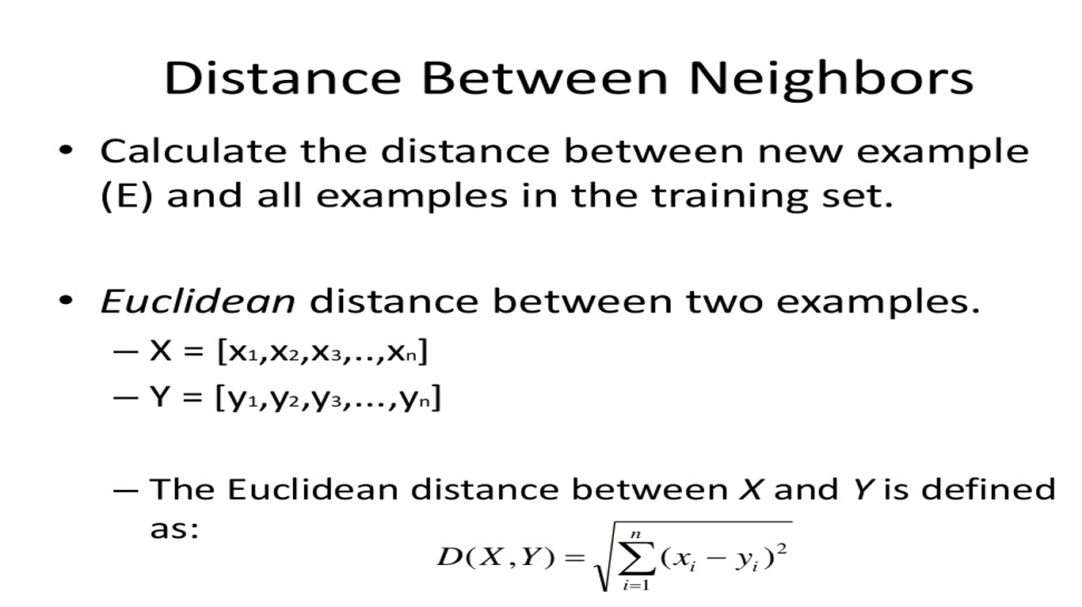

Slide 21
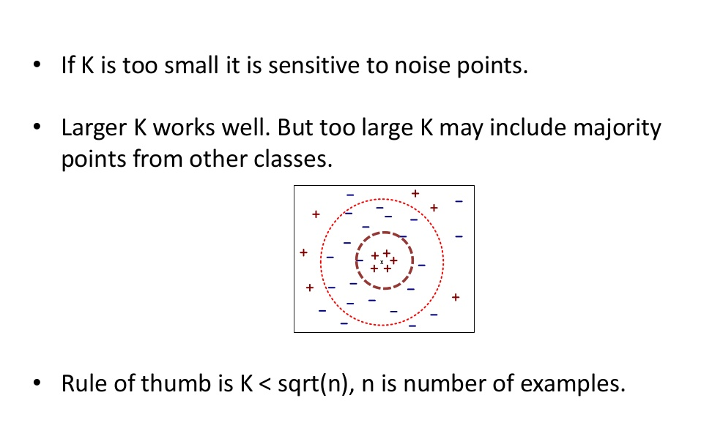
How to choose K?

Slide 22
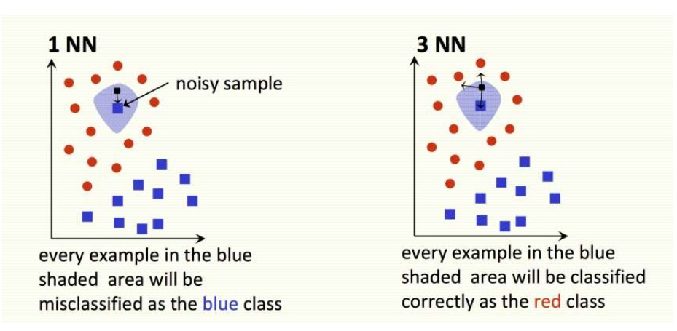
How to choose K?

Slide 23
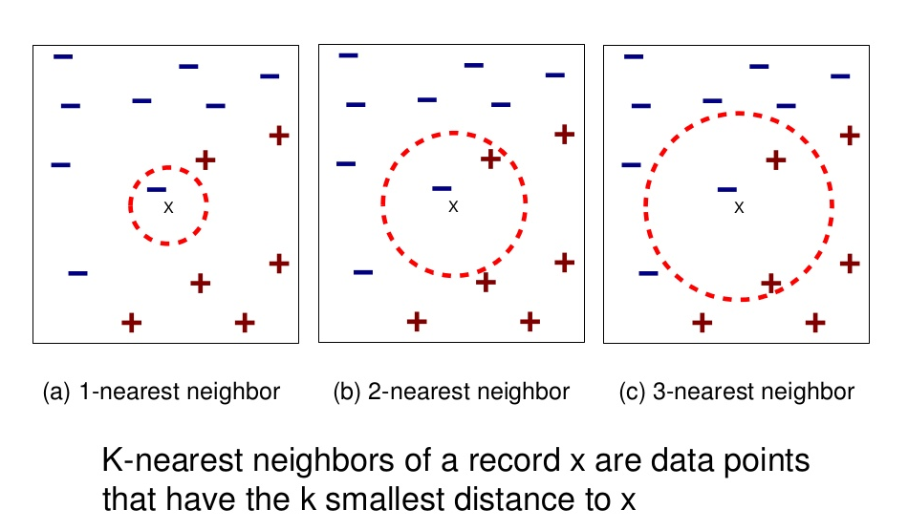
How to choose K?

Slide 24
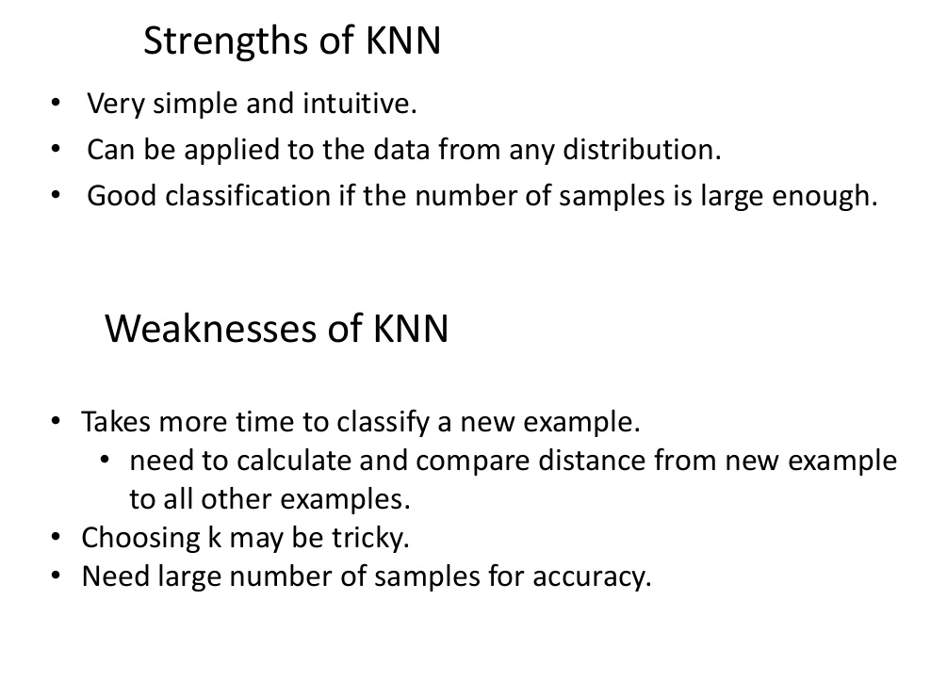
Strengths and Weaknesses of KNN

Slide 25
Thanks

